Slide 1

Chapter 03
MACRO ECONOMICS CONCEPTS
CONCEPTS OF ECONOMICS

Slide 2
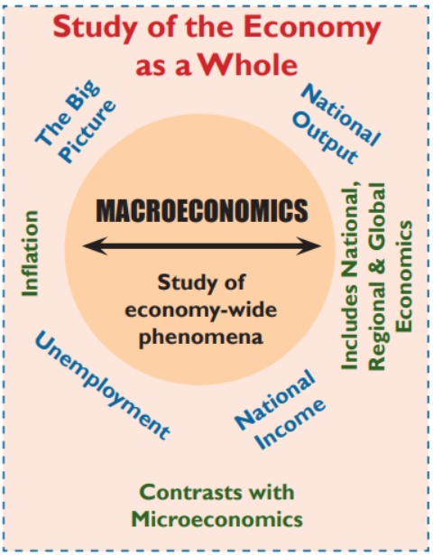
Introduction
Concepts of Economics
Macro economics concepts

Slide 3
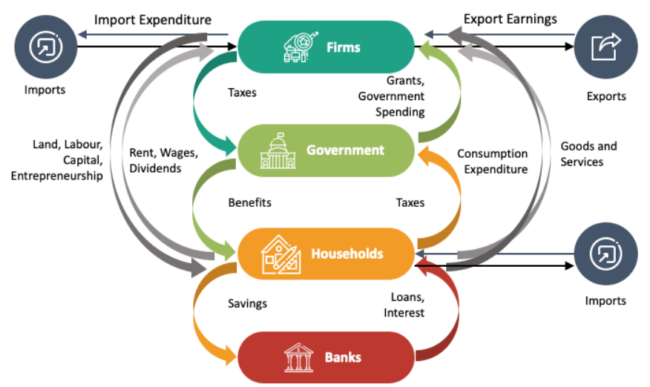
Components of Macroeconomics
Concepts of Economics
Macro economics concepts

Slide 4
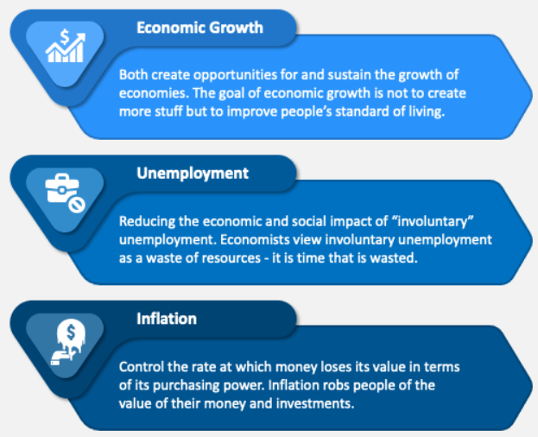
Macroeconomic Concerns
Concepts of Economics
Macro economics concepts

Slide 5
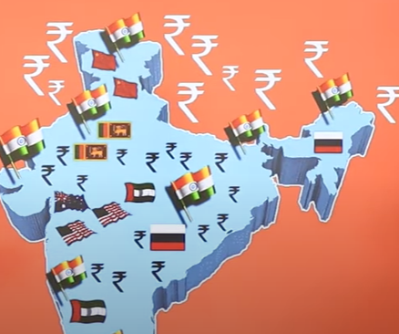

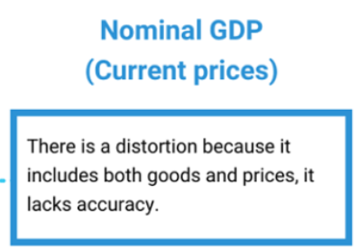
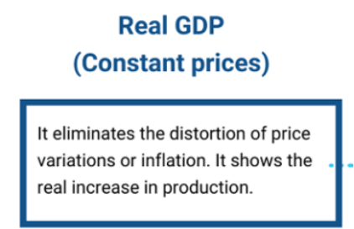
Fundamental Concepts
Concepts of Economics
1. National Income
Gross Domestic Product (GDP)
Macro economics concepts

Slide 6

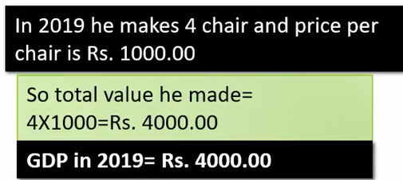
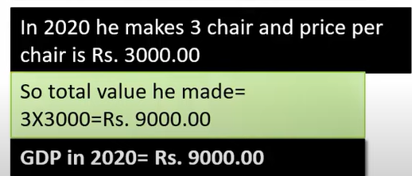



Fundamental Concepts
Concepts of Economics
1. National Income
Gross Domestic Product (GDP)
Macro economics concepts

Slide 7
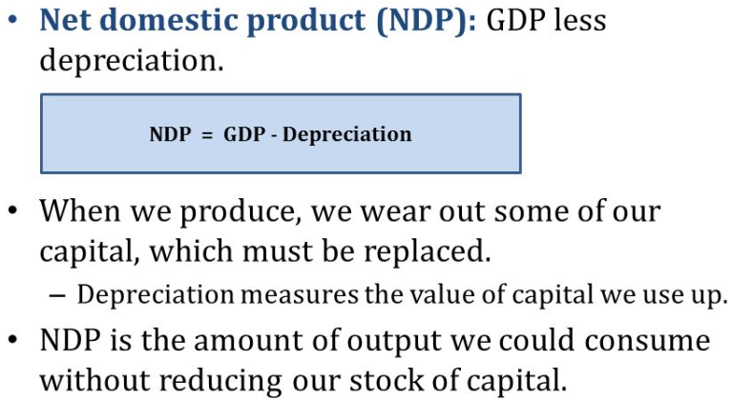
Fundamental Concepts
Concepts of Economics
1. National Income
Net Domestic Product (NDP)
Macro economics concepts

Slide 8

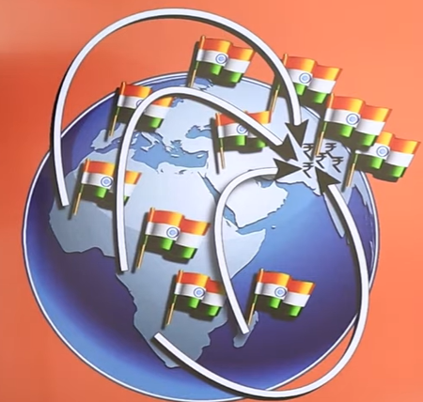
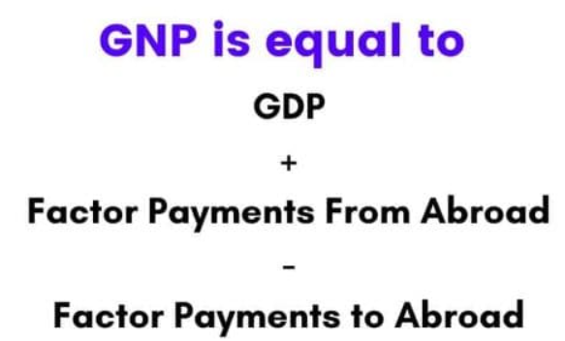
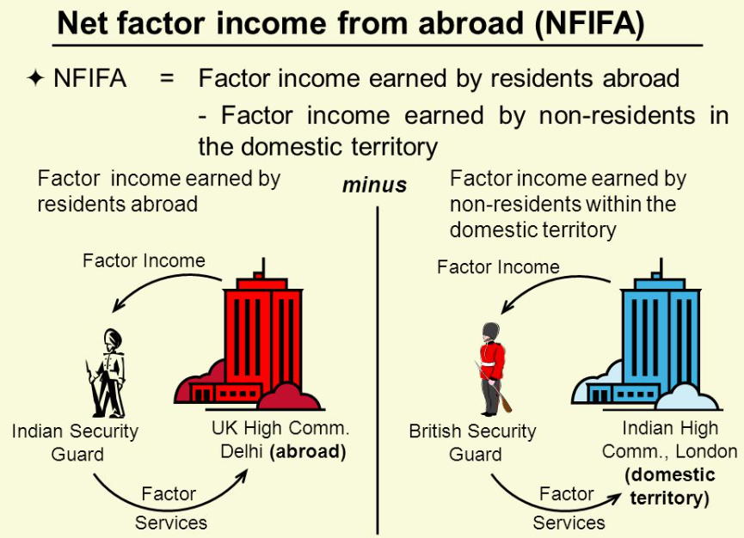
Fundamental Concepts
Concepts of Economics
1. National Income
Gross National Product (GNP)
Macro economics concepts

Slide 9
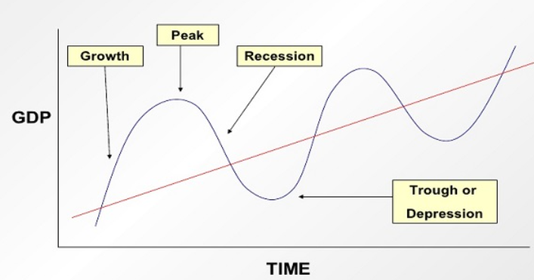
Fundamental Concepts
Concepts of Economics
2. Business Cycle
Macro economics concepts

Slide 10
Fundamental Concepts
Concepts of Economics
3. Inflation
Inflation is defined as a sustained increase in the price level or a sustained fall in the value of money.
To quantify the amount of inflation in the economy, indicators such as the Wholesale Price Index, the Consumer Price Index are used.
It measures the changes in prices that have occurred between the base year and the current year.
Macro economics concepts

Slide 11
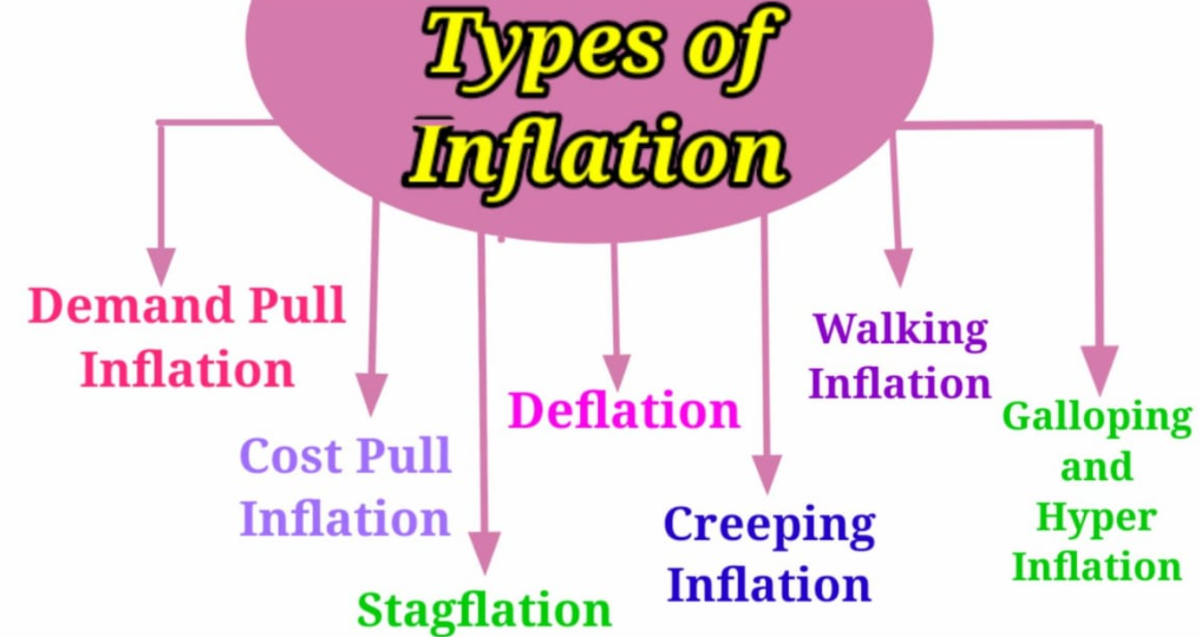
Fundamental Concepts
Concepts of Economics
3. Inflation
Macro economics concepts

Slide 12
Fundamental Concepts
Concepts of Economics
3. Types of Inflation
Deflation
State in which the price are falling and thus purchasing power of money is increasing.
Creeping Inflation
Annual price rise varies between 2% and 3%. It also known as mild- inflation.
Walking Inflation
Rate of annual price increases lies between 3% and 4% then we have a situation of walking inflation.
Macro economics concepts

Slide 13
Fundamental Concepts
Concepts of Economics
3. Types of Inflation
Galloping Inflation
Prices rise at 20%-100% rates per annum. It tends to distort relative prices and results in disquieting changes in distribution of purchasing power of different groups of income earners.
Hyper Inflation
Thousand or a million or even a billion per cent per year.
Prices and money supply rise alarmingly.
Germany experienced hyper inflation during 1920-23.
Generally, a result of war, political revolution or some other catastrophic event.
Macro economics concepts

Slide 14
Fundamental Concepts
Concepts of Economics
3. Types of Inflation
Demand Pull Inflation
It means to the phenomenon when prices consistently rises because demand is more than supply of goods and services. Too much money chasing too few goods.
Cost Push Inflation
Situation where price persistently rise because of growing factor costs.
Stagflation
is an economic situation characterized by the simultaneous occurrence of stagnant economic growth, high unemployment, and high inflation.
Macro economics concepts

Slide 15
Fundamental Concepts
Concepts of Economics
3. Types of Inflation
Money Supply - Demand Pull Theory
Disposable income and consumer expenditures
Reduction in direct or indirect taxation
Depreciation in exchange rate
Business Outlays – Cost Push Theory
Rising imported raw materials costs
Rising labour costs
Higher indirect taxes imposed by govt
Macro economics concepts

Slide 16
Monetary Policy
Concepts of Economics
Monetary policy is the process by which the monetary authority of a country controls the supply of money, often targeting a rate of interest for the purpose of promoting economic growth and stability.
The term monetary policy refers to actions taken by central banks to affect monetary magnitudes or other financial conditions.
Monetary Policy operates on monetary magnitudes or variables such as money supply, interest rates and availability of credit.
Monetary Policy ultimately operates through its influence on expenditure flows in the economy.
In other words, affects liquidity and by affecting liquidity, and thus credit, it affects total demand in the economy.
Macro economics concepts

Slide 17
Monetary Policy
Concepts of Economics
Credit Policy
Central Bank (RBI) may directly affect the money supply to control its growth.
It might act indirectly to affect cost and availability of credit in the economy.
In modern times the bulk of money in developed economies consists of bank deposits rather than currencies and coins.
RBI today guide monetary developments with instruments that control over deposit creation and influence general financial conditions.
Credit policy is concerned with changes in the supply of credit.
Central Bank administers both the Credit and Monetary policy
Macro economics concepts

Slide 18
Monetary Policy
Concepts of Economics
Aims
Reasonable Price Stability
Full employment
Stable exchange rate
Economic growth
Greater equality in distribution of income & wealth
Financial stability
Macro economics concepts

Slide 19
Monetary Policy
Concepts of Economics
Price Stability – The Dominant Objective
Does not mean complete year-to-year price stability which is difficult to attain.
Refers to the long run average stability of prices.
Involves avoidance of both inflationary and deflationary pressures.
Contributes improvements in the standard of living of people.
Leads to interest rate stability, and exchange rate stability (via export import stability).
Contributes to the overall financial stability of the economy.
Macro economics concepts

Slide 20
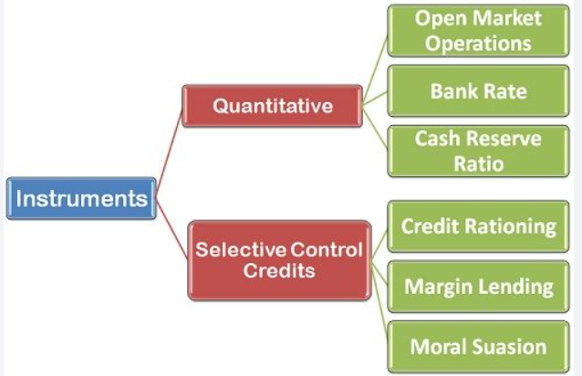
Monetary Policy
Concepts of Economics
Instruments of Monetary Policy
Macro economics concepts

Slide 21
Monetary Policy - Instruments
Concepts of Economics
1. Open Market Operations
OMOs involve buying (outright or temporary) and selling of govt. securities by the central bank, from or to the public and banks.
In times of inflation, RBI sells securities to mop up the excess money in the market. Similarly, to increase the supply of money, RBI purchases securities.
Macro economics concepts

Slide 22
Monetary Policy - Instruments
Concepts of Economics
2. Bank Rates
Bank rate: Rate of interest charged by the central bank for providing funds or loans to the banking system.
Raising Bank Rate raises cost of borrowing by commercial banks, causing reduction in credit volume to the banks, and decline in money supply.
Market regards the increase in Bank rate as the official signal for beginning of a tight money situation.
Macro economics concepts

Slide 23
Monetary Policy - Instruments
Concepts of Economics
3. Repo and Reverse Repo Rate
Repo Rate: Rate at which the RBI lends to commercial banks by purchasing securities while bank rate loans are unsecured.
Reverse Repo Rate: The reverse repo rate is the rate at which the RBI borrows funds from the country's commercial banks.
It is the rate where the commercial banks in India park excess funds with the Reserve Bank of India, typically for a short period of time.
Macro economics concepts

Slide 24
Monetary Policy - Instruments
Concepts of Economics
4. Reserve Ratio
Cash Reserve Ratio: CRR is the percentage of money, which a bank has to keep with RBI in the form of cash.
Statutory Liquidity Ratio: SLR is the minimum percentage of deposits that a commercial bank has to maintain in the form of liquid cash, gold or other securities.
Macro economics concepts

Slide 25
Monetary Policy - Instruments
Concepts of Economics
Selective Credit Controls
Credit Rationing: RBI fixes a ceiling (maximum limit) on loans and advances of various categories, which the commercial banks cannot exceed. This controls the amount of credit for certain sectors and ensures that all sectors get adequate credit. Required for inclusive growth of all sectors.
Margin Lending: Type of loan that allows you to borrow money to invest, by using your existing shares, managed funds and/or cash as security.
Moral Suasion: Type of influencing procedure which is applied by Central Banks to keep the pressure on commercial banks in order to abide by the monetary policies that are established. It is carried out by transferring speeches, seminars and meetings.
Macro economics concepts

Slide 26
Fiscal Policy
Concepts of Economics
The word fisc means ‘state treasury’ and fiscal policy refers to policy concerning the use of ‘state treasury’ or the govt. finances to achieve the macroeconomic goals.
“Any decision to change the level, composition or timing of govt. expenditure or to vary the burden, the structure or frequency of the tax payment is fiscal policy.”
The two main instruments of fiscal policy are government expenditure and taxation.
Macro economics concepts

Slide 27
Fiscal Policy
Concepts of Economics
Fiscal Policy and Macro Economic Goals
Economic Growth: Creating conditions for increase in savings & investment.
Employment: Encouraging the use of labour- absorbing technology
Stabilization: Fight with depressionary trends and booming (overheating) indications in the economy
Economic Equality: Reducing the income and wealth gaps between the rich and poor.
Price Stability: Employed to contain inflationary and deflationary tendencies in the economy.
Macro economics concepts

Slide 28
Fiscal Policy
Concepts of Economics
Aggregate demand, which is the total demand for goods and services in the economy, depends on three main variables - consumption, private investment and government spending.
When the government increases its expenditure then it spurs the aggregate demand in the economy.
A higher aggregate demand in turn will stimulate output, growth and employment.
Whereas if the government lowers it’s spending then it decreases the aggregate demand and hence slows down the growth of the economy.
Macro economics concepts

Slide 29
Fiscal Policy
Concepts of Economics
When Govt. makes use of its revenue and expenditure programmes and affects the aggregate level of demand for goods and services in the economy, then this action is essentially known as fiscal policy. (Union Budget)
Related to fiscal policy are deficits and surpluses. When the government’s expenditure exceeds its revenue, then there is a fiscal deficit and the opposite of this is known is fiscal surplus. Government should cut taxes and increase spending to bring the economy out of a slump, this kind of a policy action is known is expansionary fiscal policy.
Govt. should increase taxes and cut expenditure to bring the economy out of inflationary pressure, that is, it should follow a contractionary fiscal policy.
Macro economics concepts

